Slide 1


DR.JOY Vietnam

Slide 2

Mission
Dr.JOY’s mission is creating communication infrastructure in medical industry to enhance efficiency and safety of large quantity of hospitals as well as medical institutions.

Slide 3
Our product
SNS
Time attendance management
Drug’s side effect search
Appointment arrangement
Web meeting & presentation
Virtual MR

Slide 4
Future of JOYTek
Big Data: Utilize behavioral data of medical institutions and pharmaceutical companies to improve medical efficiency, provide effective information, and reform work styles
IoT: Develop a new era of attendance management system which automatically records daily working hours simply by linking Beacon installed at hospitals with Dr.JOY app in mobile phone
AI Chatbot: Automatically respond to medical staff’s questions about medicines

Slide 5
Why Dr.JOY?
Product development
As one of global team, Dr.JOY Vietnam also take part in creating software design and architecture
Potential domain
We focus on medical and healthcare industry which is one of the highest potential of development in the future
Start-up environment
Flat, open and fast-paced environment
Welcome members’ opinions & ideas by survey all members
Training Course
We focus on developing both hard and soft skills for employees, which are organized with many topics. Some of courses/seminars we have deployed:
MongoDB Performance, Angular, Unit Test, Kaizen, Agile,..
Tech stack
Microservices
Spring, Kotlin, Swift, Angular
Google Cloud Services
Kubernetes, Docker
Office facilities
Macbook Pro 2019 & other high-spec PCs
Bright office with West Lake view
Open space with Book corner and free snack & drink

Slide 6
Why Dr.JOY?
Attractive Benefit
Salary review: 2 times/ year
Bonus: fixed 13th salary + quarterly bonuses of up to 2-month salary
PVI Premium Health Care and annually Healthcheck program for all
Transportation allowance (VND 200,000) and more allowance for women
Free clubs (yoga, badminton, swimming, poker,...) & Japanese classes
Various corporate events, from sports competitions, monthly birthday parties, quarterly team building to New Year party, company trip etc.
Labor Union’s subsidiaries and gifts for holidays, healthcare, etc.
Allowance for employees who share knowledge and implement the training course for colleagues
Free book corner with new books being purchased every month
Free snack, coffee, tea available

Slide 7

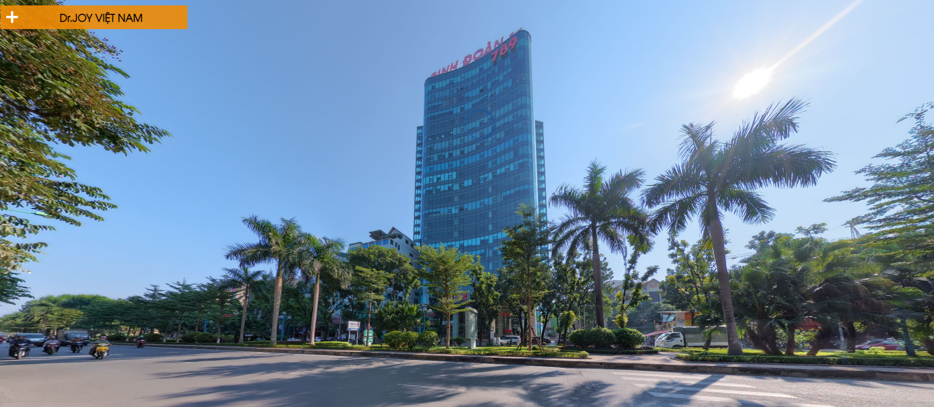
Our office
CLICK TO VIEW

Slide 8
Job opportunities
BrSE cum Project Manager
Salary: Up to $3,000
<Scope of work>
• Communicate with Japanese HQ to develop high-quality software design and architecture.
• Applies project management knowledge and uses personal and leadership skills to achieve project success
• Leads and directs the project planning efforts
• Selects appropriate processes for the project
• Develops the team
Your Skills and Experience
<Must have>
・Experienced in Project Management of at least 5 members: 3 years or above
・Ability to use Japanese in daily conversation (JLPT N2 equivalent or above)
・Good team communication
・Good understanding of Vietnam and Japan's culture and practices
・Experience creating business application specifications and design documents
・Strong project management knowledge and leadership
<Nice to have>
・Have solid knowledge of one of the following: Web Backend / Web Frontend / iOS / Android / QA

Slide 9
Job opportunities
Senior Java Developer
Salary: Up to $2,000
<Scope of work>
・Design, code and test system or product's function after creating
・Create plan, implement and monitor development progresses
・Research new technology to apply into current projects
Your Skills and Experience
<Must have>
・Java (8 or more)：3 years or more
・Experience in creating basic design
・Experience in designing Database
・Ability to make highly maintainable code
・Object-Oriented Programming
<Nice to have>
・Spring boot / Spring framework
・gRPC(Protocol Buffers)
・Docker
・Kubernetes
・MongoDB

Slide 10
Hiring process
Online Interview
(by Division Manager)
Online Test
(at home)
Direct Interview
(by CEO)

Slide 11
THANKS!
For further info, please take a look at what we are doing at:
https://www.youtube.com/watch?v=aQKX9A-xafs&feature=emb_logo
Send CV to: recruitment@drjoy.vn
Fanpage: https://www.facebook.com/DrJOYvietnam

